Slide 1
CONSTRAINT SATISFACTION PROBLEMS
Course Code: CSC4226
Course Title: Artificial Intelligence and Expert System
Dept. of Computer Science
Faculty of Science and Technology
Lecture No: | Eight (7) | Week No: | Eight (8) | Semester:
Lecturer: | Dr. Muhammad Firoz Mridha, Associate Professor, Dept of CS Email: firoz.mridha@aiub.edu

Slide 2
Lecture Outline
Defining CSP
Varieties of CSPs
Backtracking Search for CSPs
Forward Checking
Constraint Propagation
Heuristics for CSP
Problem Structure

Slide 3
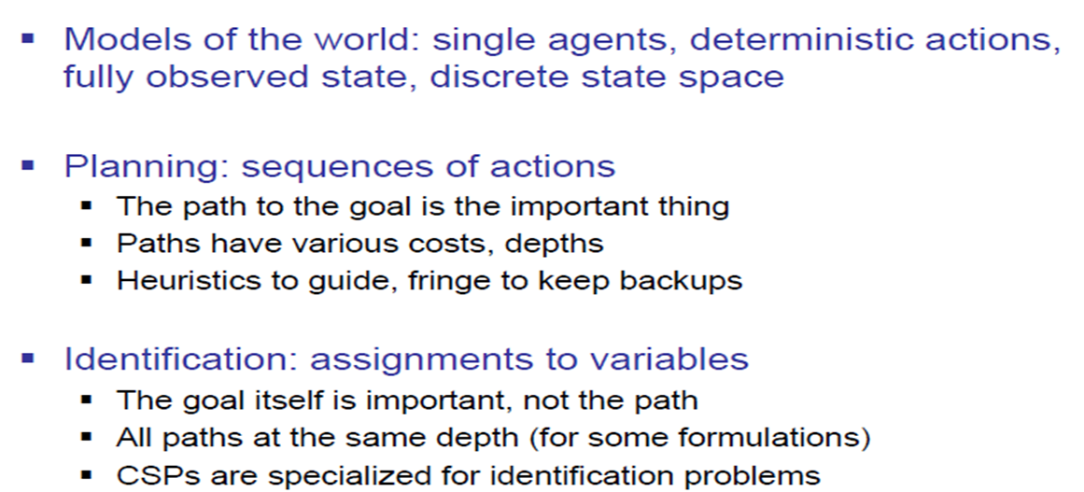
What is Search For?

Slide 4
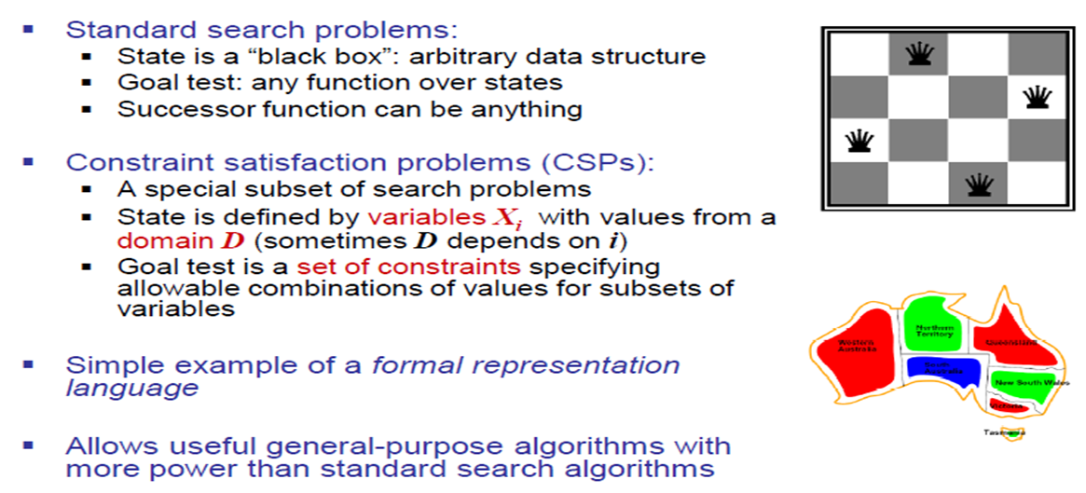
Constraint Satisfaction Problems

Slide 5
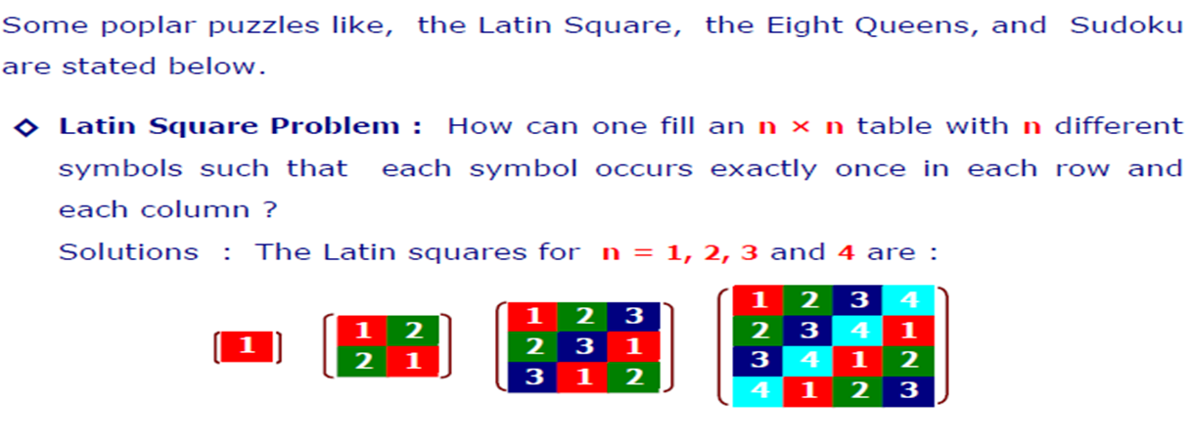
Example of CSPs

Slide 6
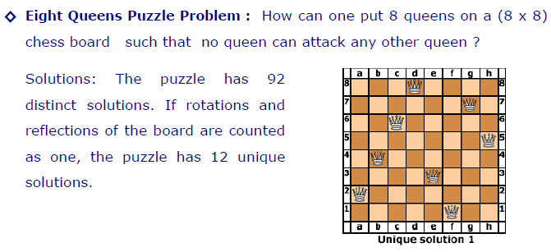
Example of CSPs

Slide 7
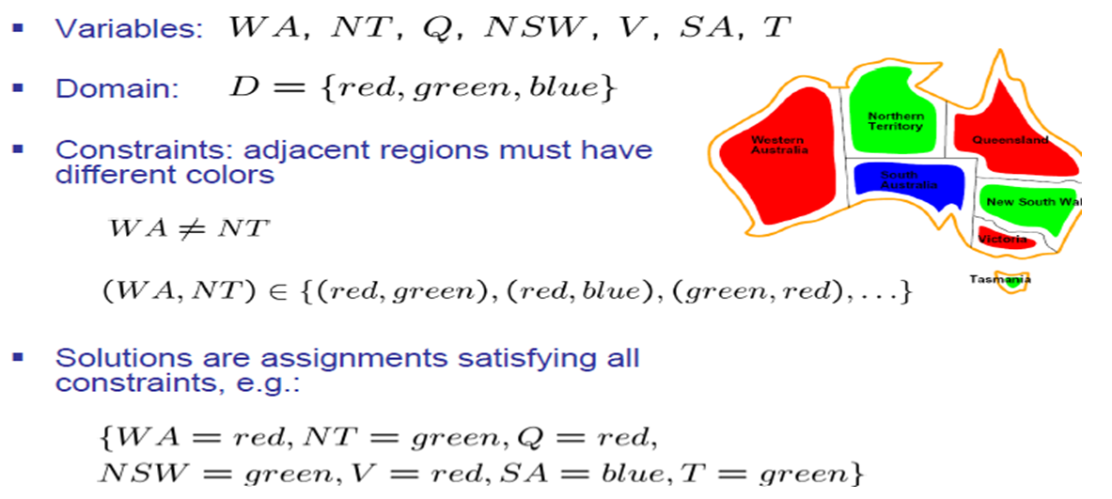
Example CSP: Map Coloring

Slide 8
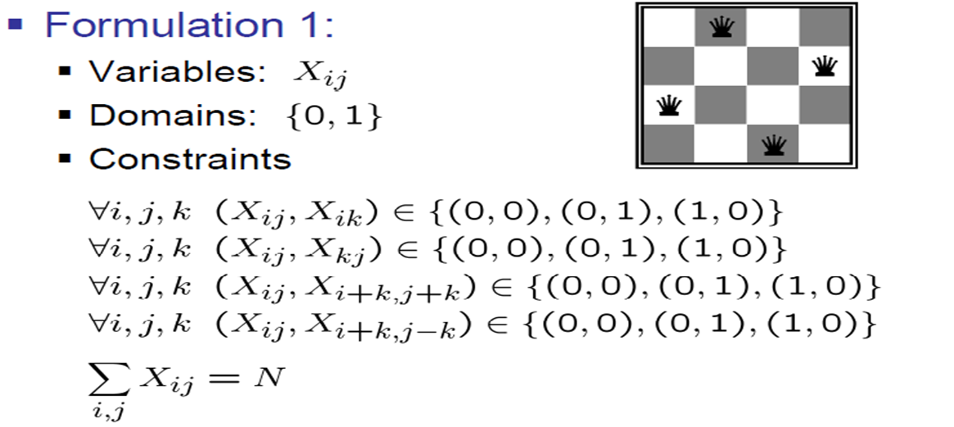
Example: N-Queens

Slide 9
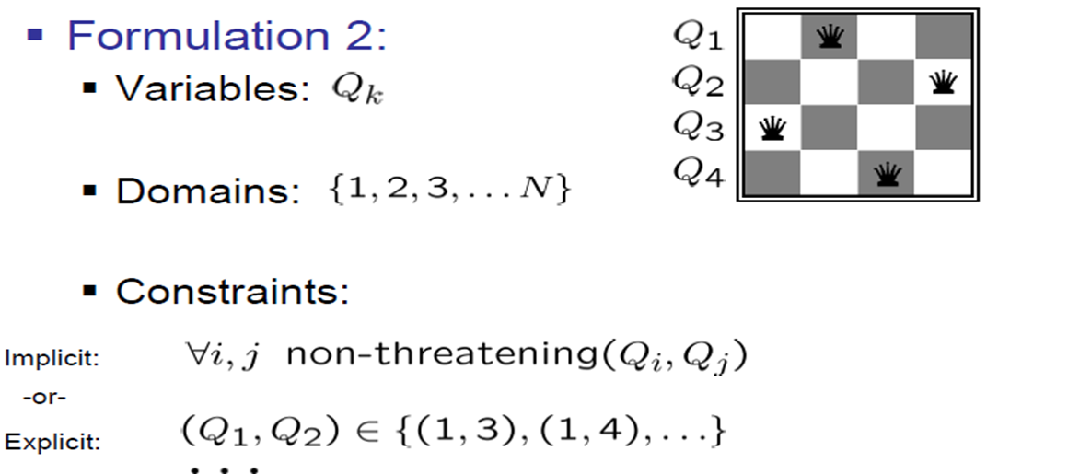
Example: N-Queens

Slide 10
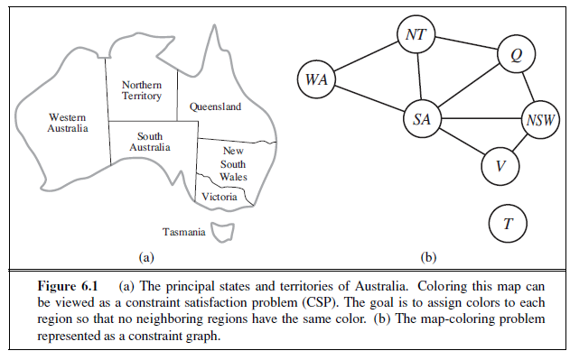
Constraint Graph

Slide 11
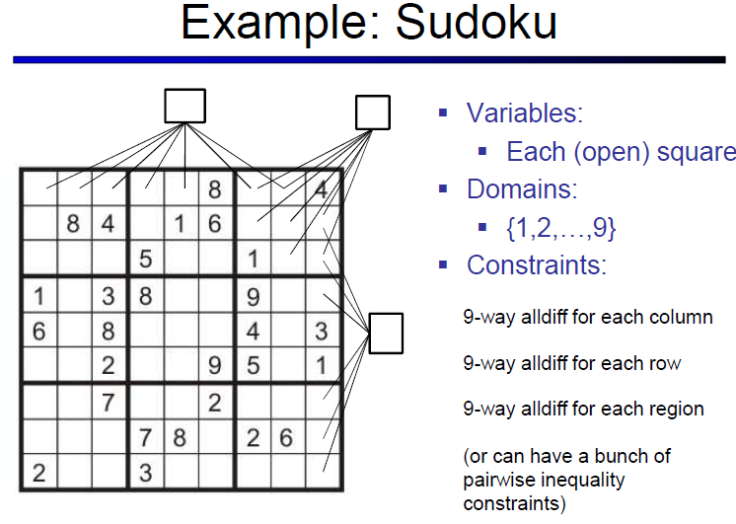

Topic Heading..

Slide 12
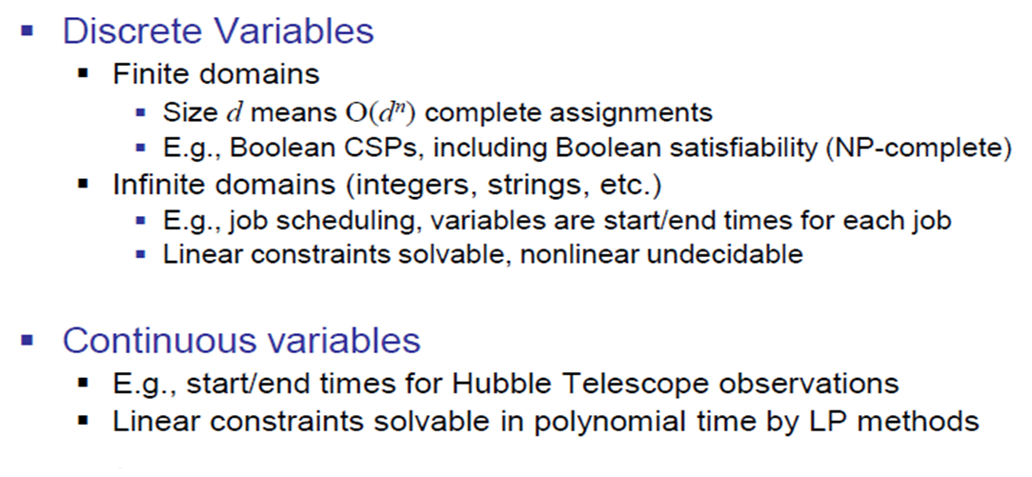
Varieties of CSPs

Slide 13
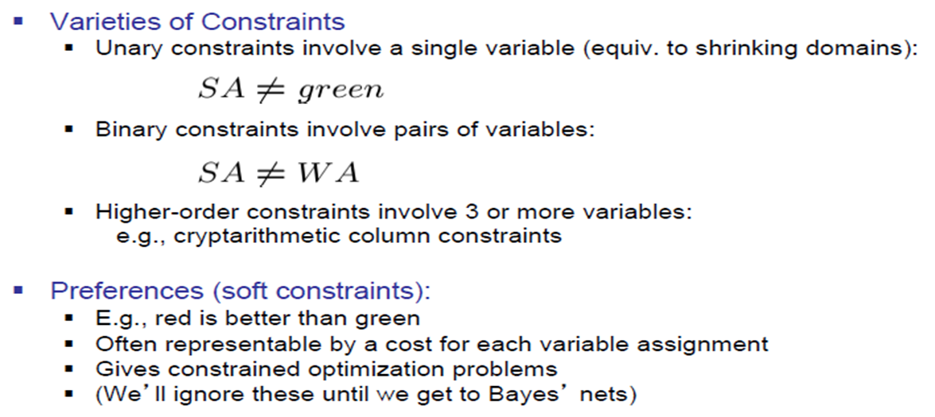
Varieties of Constraints

Slide 14
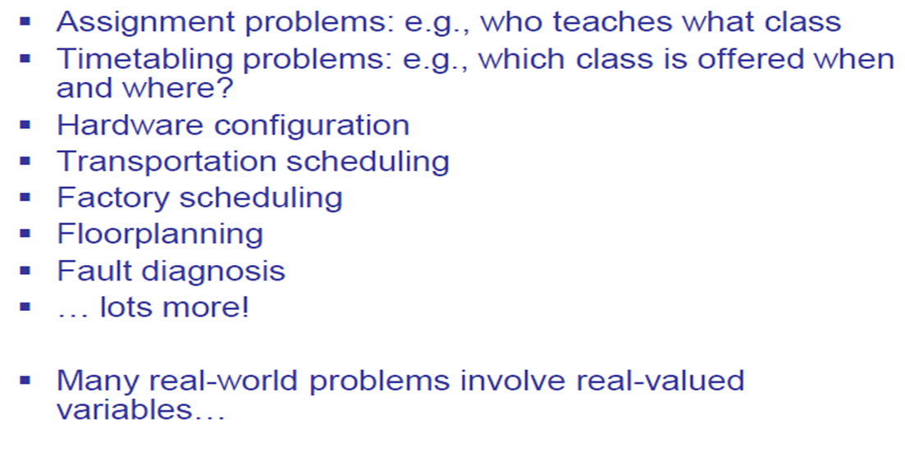
Real World CSPs

Slide 15
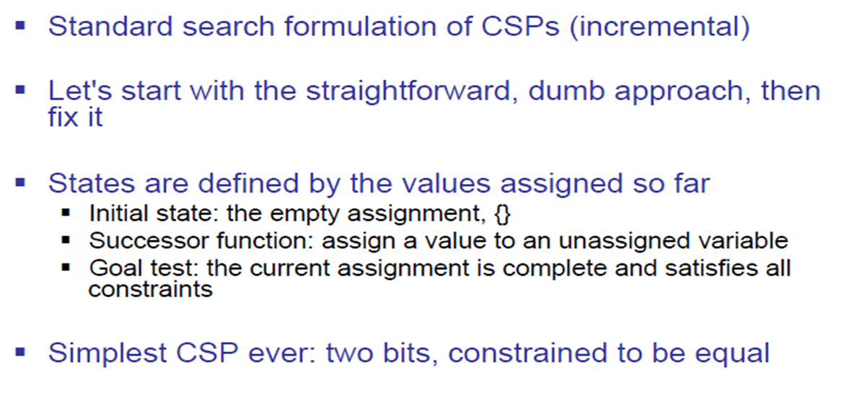
Standard Search Formulation

Slide 16
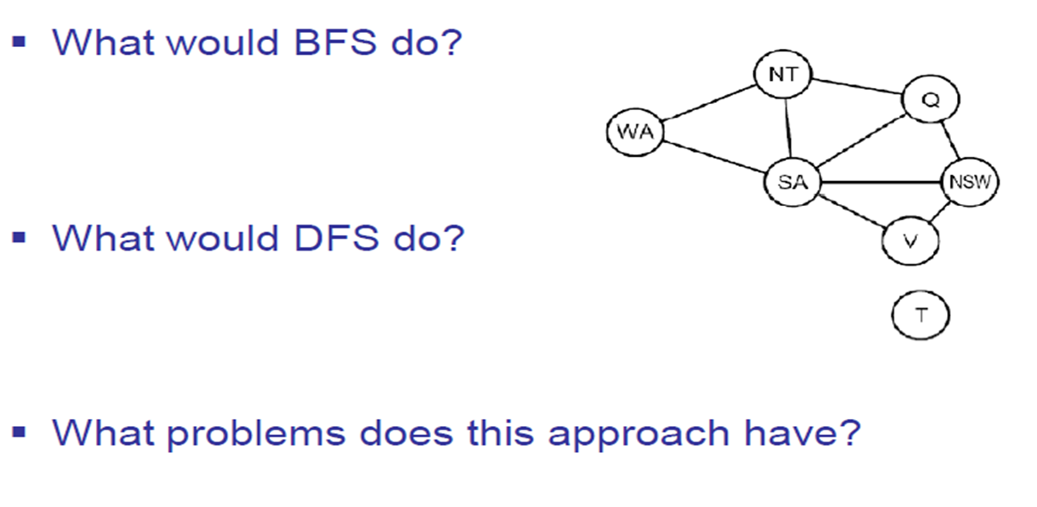
Search Methods

Slide 17
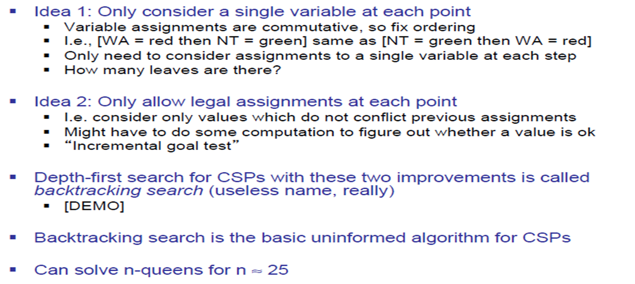
Backtracking Search

Slide 18
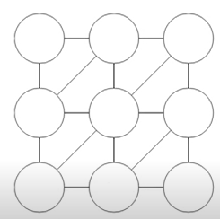
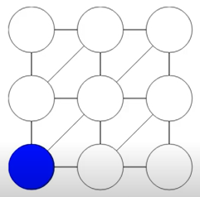
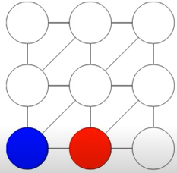
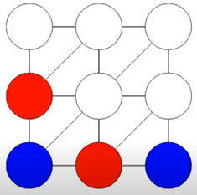
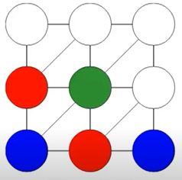
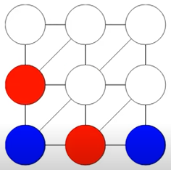
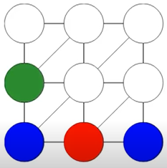
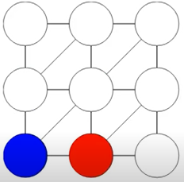
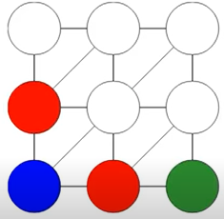
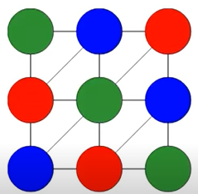
Demonstration
Assigning Value from Domain = { Blue, Red, Green} To Each Variables (circles)
from Left to Right Order
NO COLOR TO ASSIGN NEXT. BACKTRACK

Slide 19
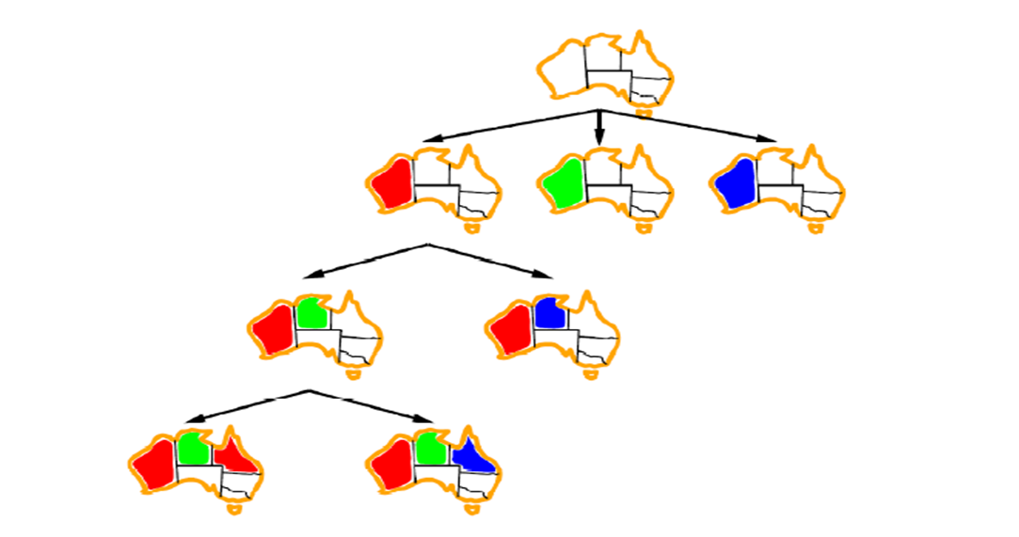
Backtracking Example

Slide 20
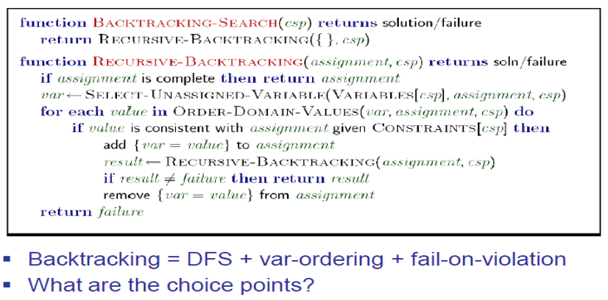
Backtracking Search

Slide 21
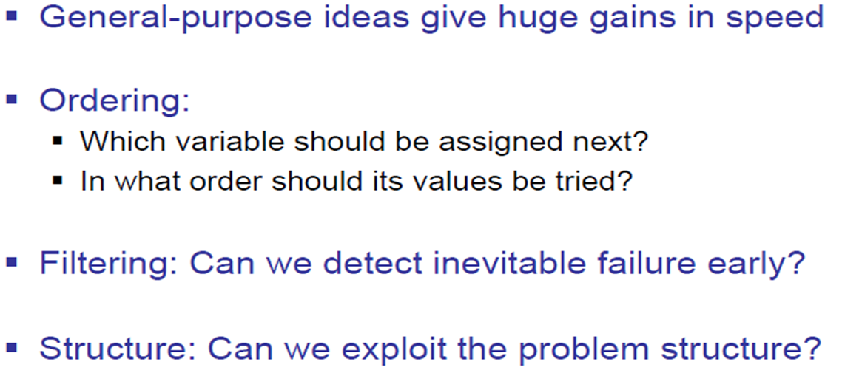
Improving Backtracking

Slide 22
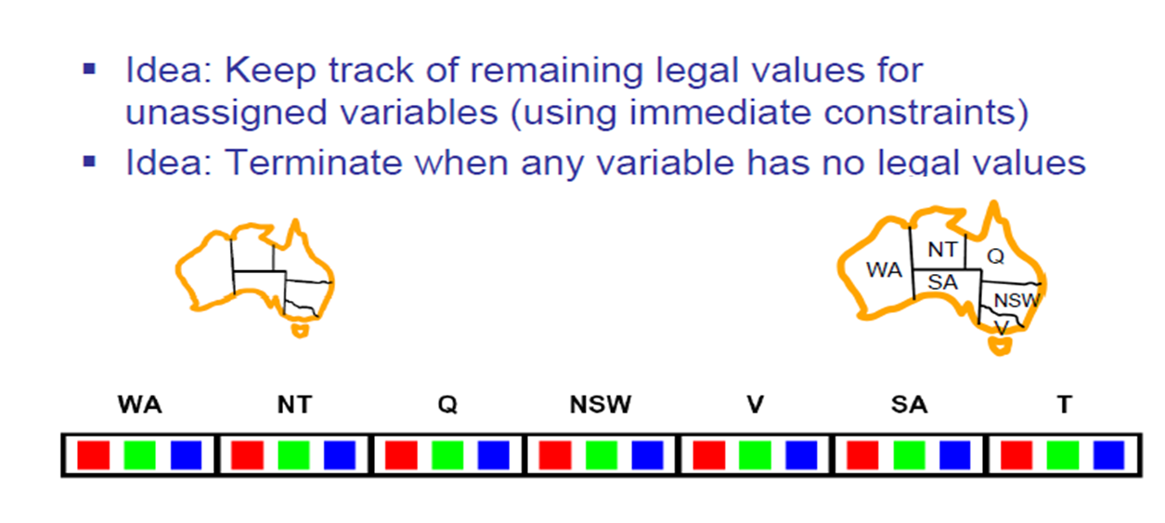
Filtering: Forward Checking

Slide 23
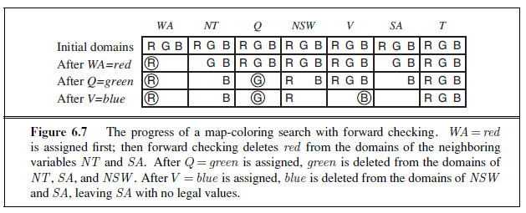
Progress of Map Coloring

Slide 24
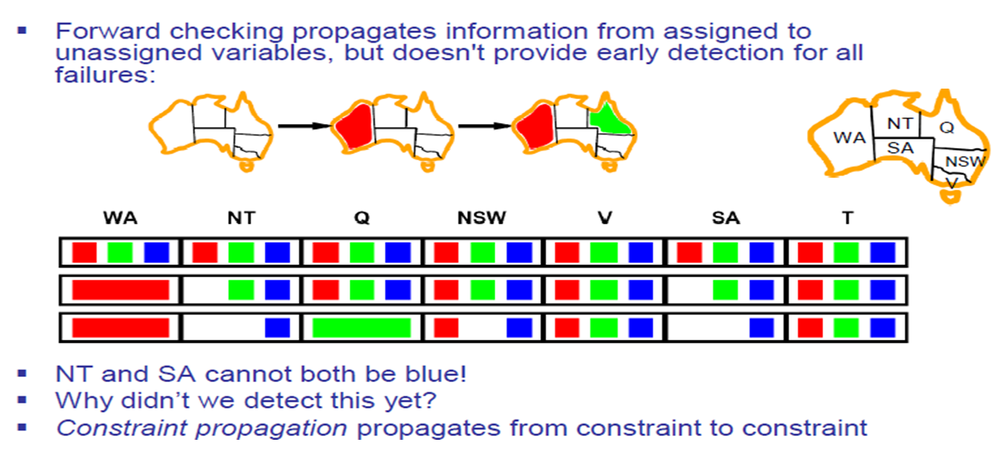
Filtering: Constraint Propagation

Slide 25
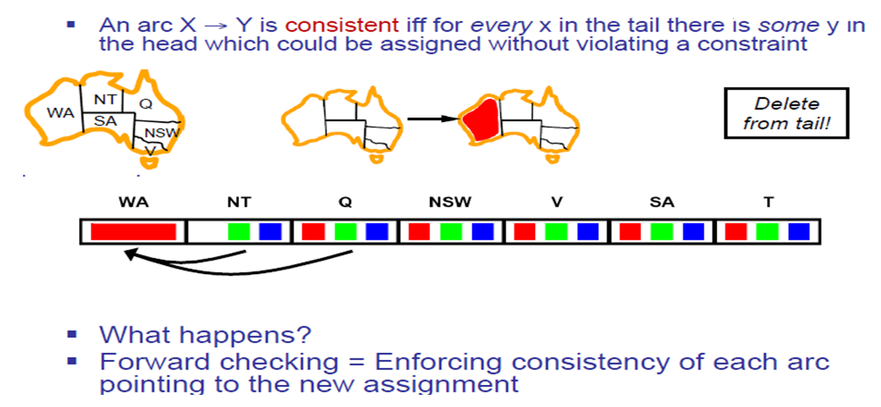
Consistency of An Arc

Slide 26
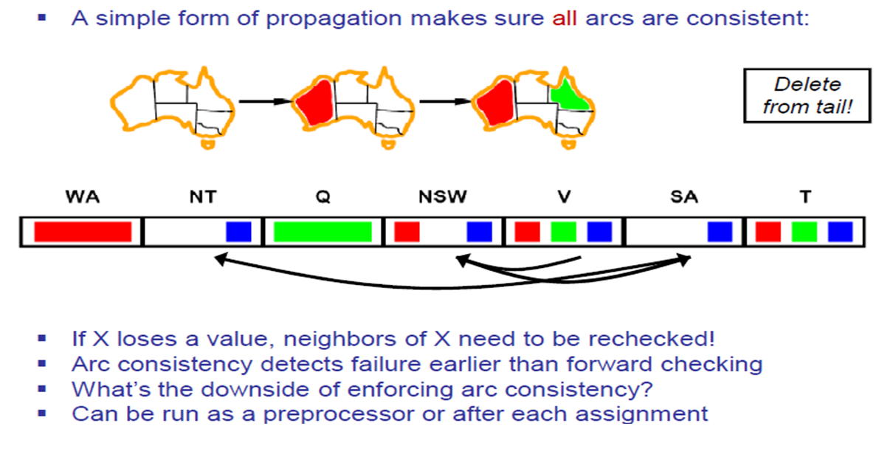
Arc Consistency of a CSP

Slide 27
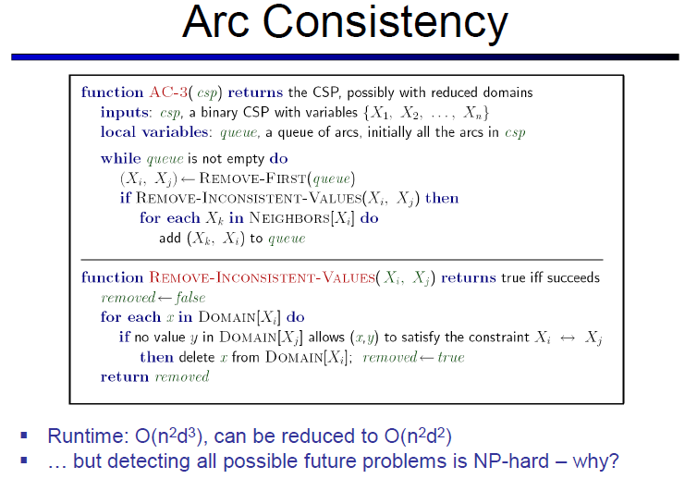
Topic Heading..

Slide 28
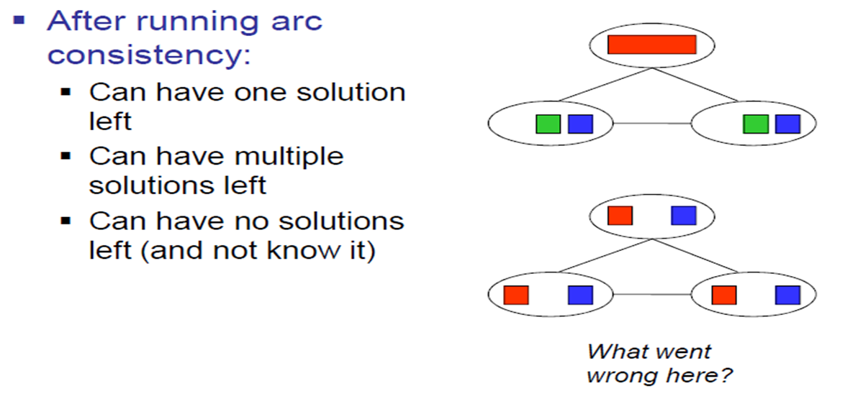
Limitations of Arc Consistency

Slide 29
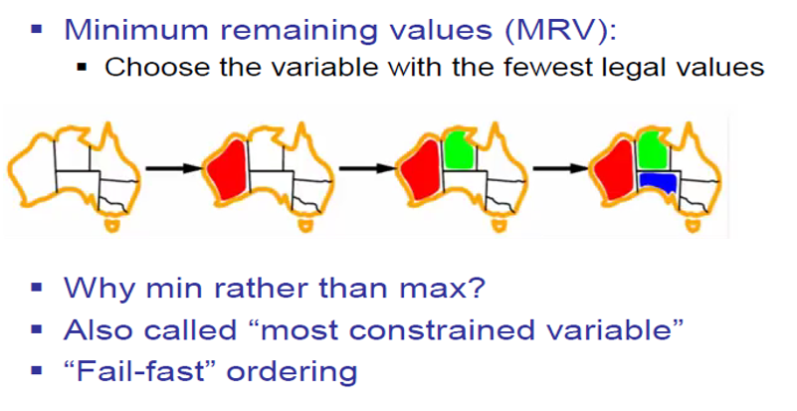
Ordering: Minimum Remaining Value

Slide 30
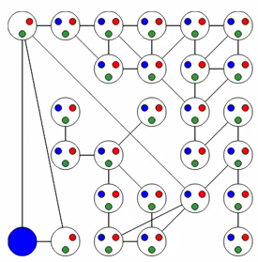
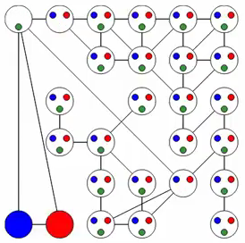
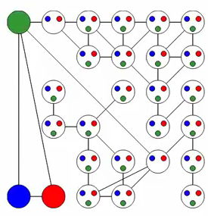
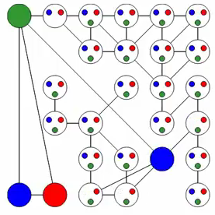
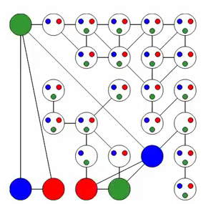
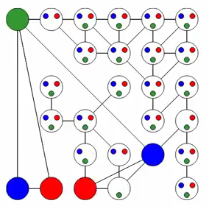
MRV: Example

Slide 31
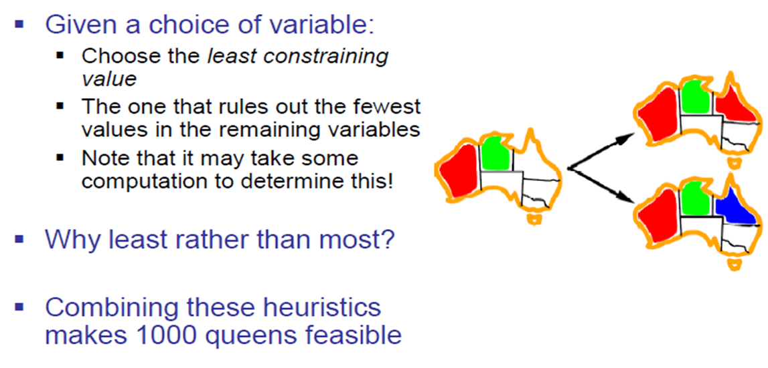
Ordering: Least Constraining Value

Slide 32
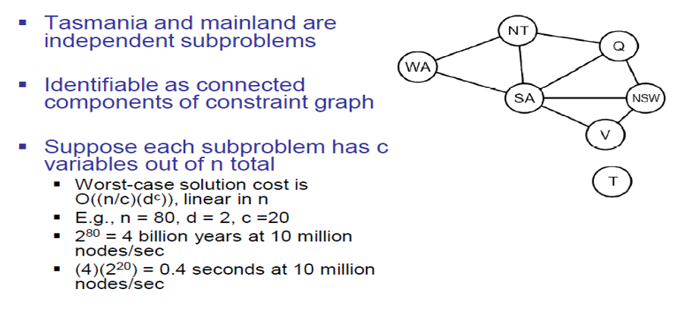
Problem Structure

Slide 33
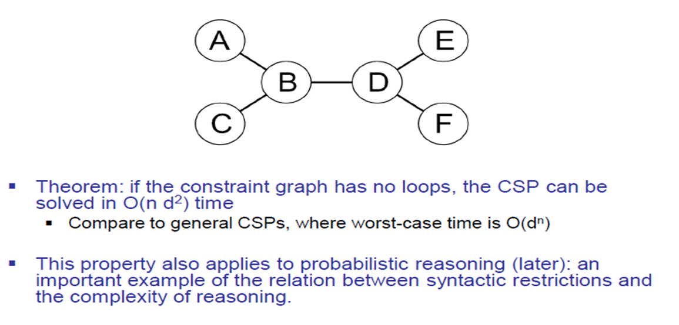
Tree Structure CSPs

Slide 34
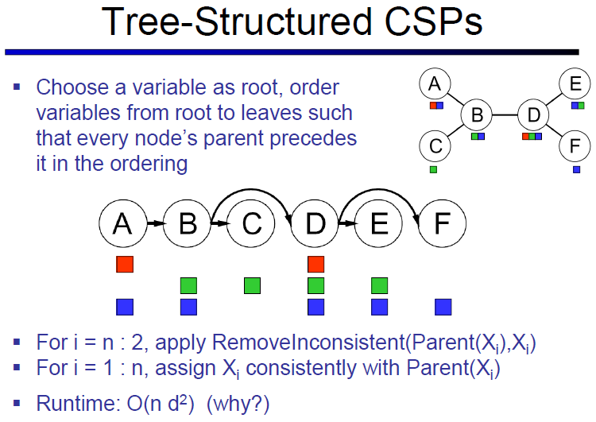
Topic Heading..

Slide 35
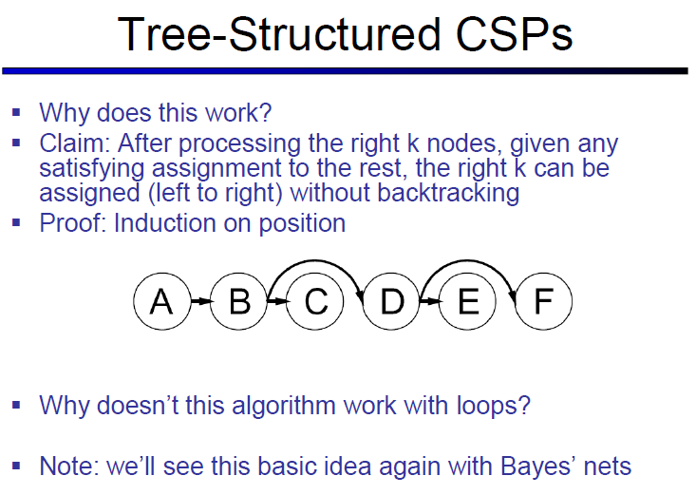
Topic Heading..

Slide 36
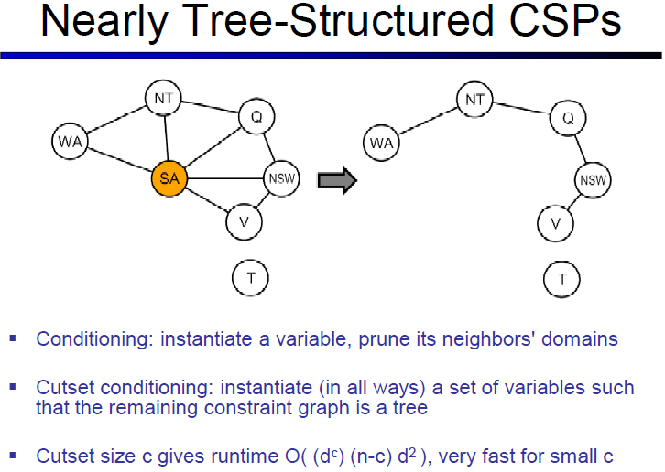

Slide 37
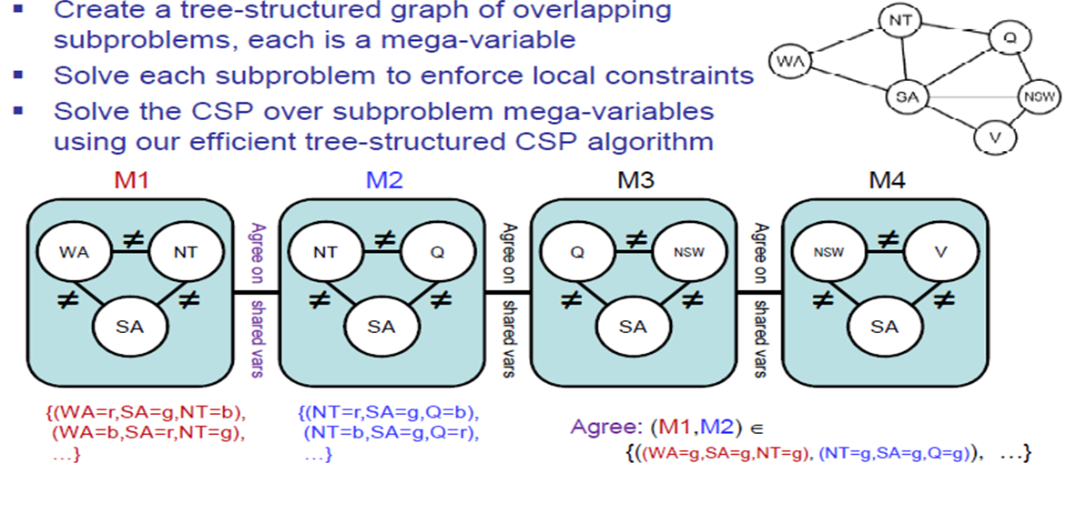
Tree Decomposition

Slide 38
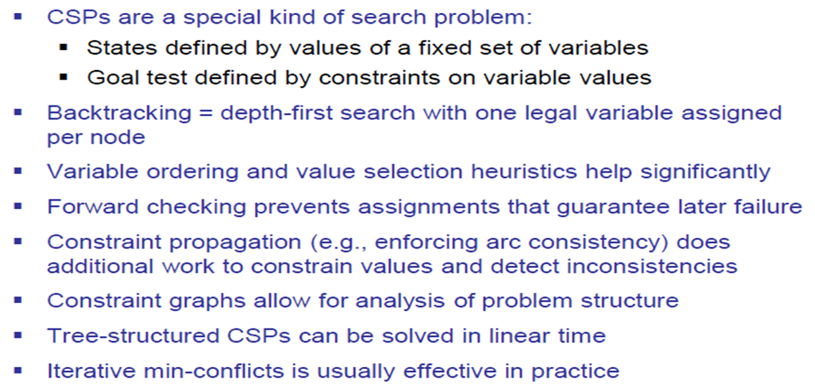
Summary

Slide 39
References
Chapter 6: Introduction , Pages 202-220
“Artificial Intelligence: A Modern Approach,” by Stuart J. Russell and Peter Norvig,

Slide 40
Books
“Artificial Intelligence: A Modern Approach,” by Stuart J. Russell and Peter Norvig.
"Artificial Intelligence: Structures and Strategies for Complex Problem Solving", by George F. Luger, (2002)
"Artificial Intelligence: Theory and Practice", by Thomas Dean.
"AI: A New Synthesis", by Nils J. Nilsson.
“Programming for machine learning,” by J. Ross Quinlan,
“Neural Computing Theory and Practice,” by Philip D. Wasserman, .
“Neural Network Design,” by Martin T. Hagan, Howard B. Demuth, Mark H. Beale, .
“Practical Genetic Algorithms,” by Randy L. Haupt and Sue Ellen Haupt.
“Genetic Algorithms in Search, optimization and Machine learning,” by David E. Goldberg.
"Computational Intelligence: A Logical Approach", by David Poole, Alan Mackworth, and Randy Goebel.
“Introduction to Turbo Prolog”, by Carl Townsend.

